Slide 1
Supervised Learning

Slide 2
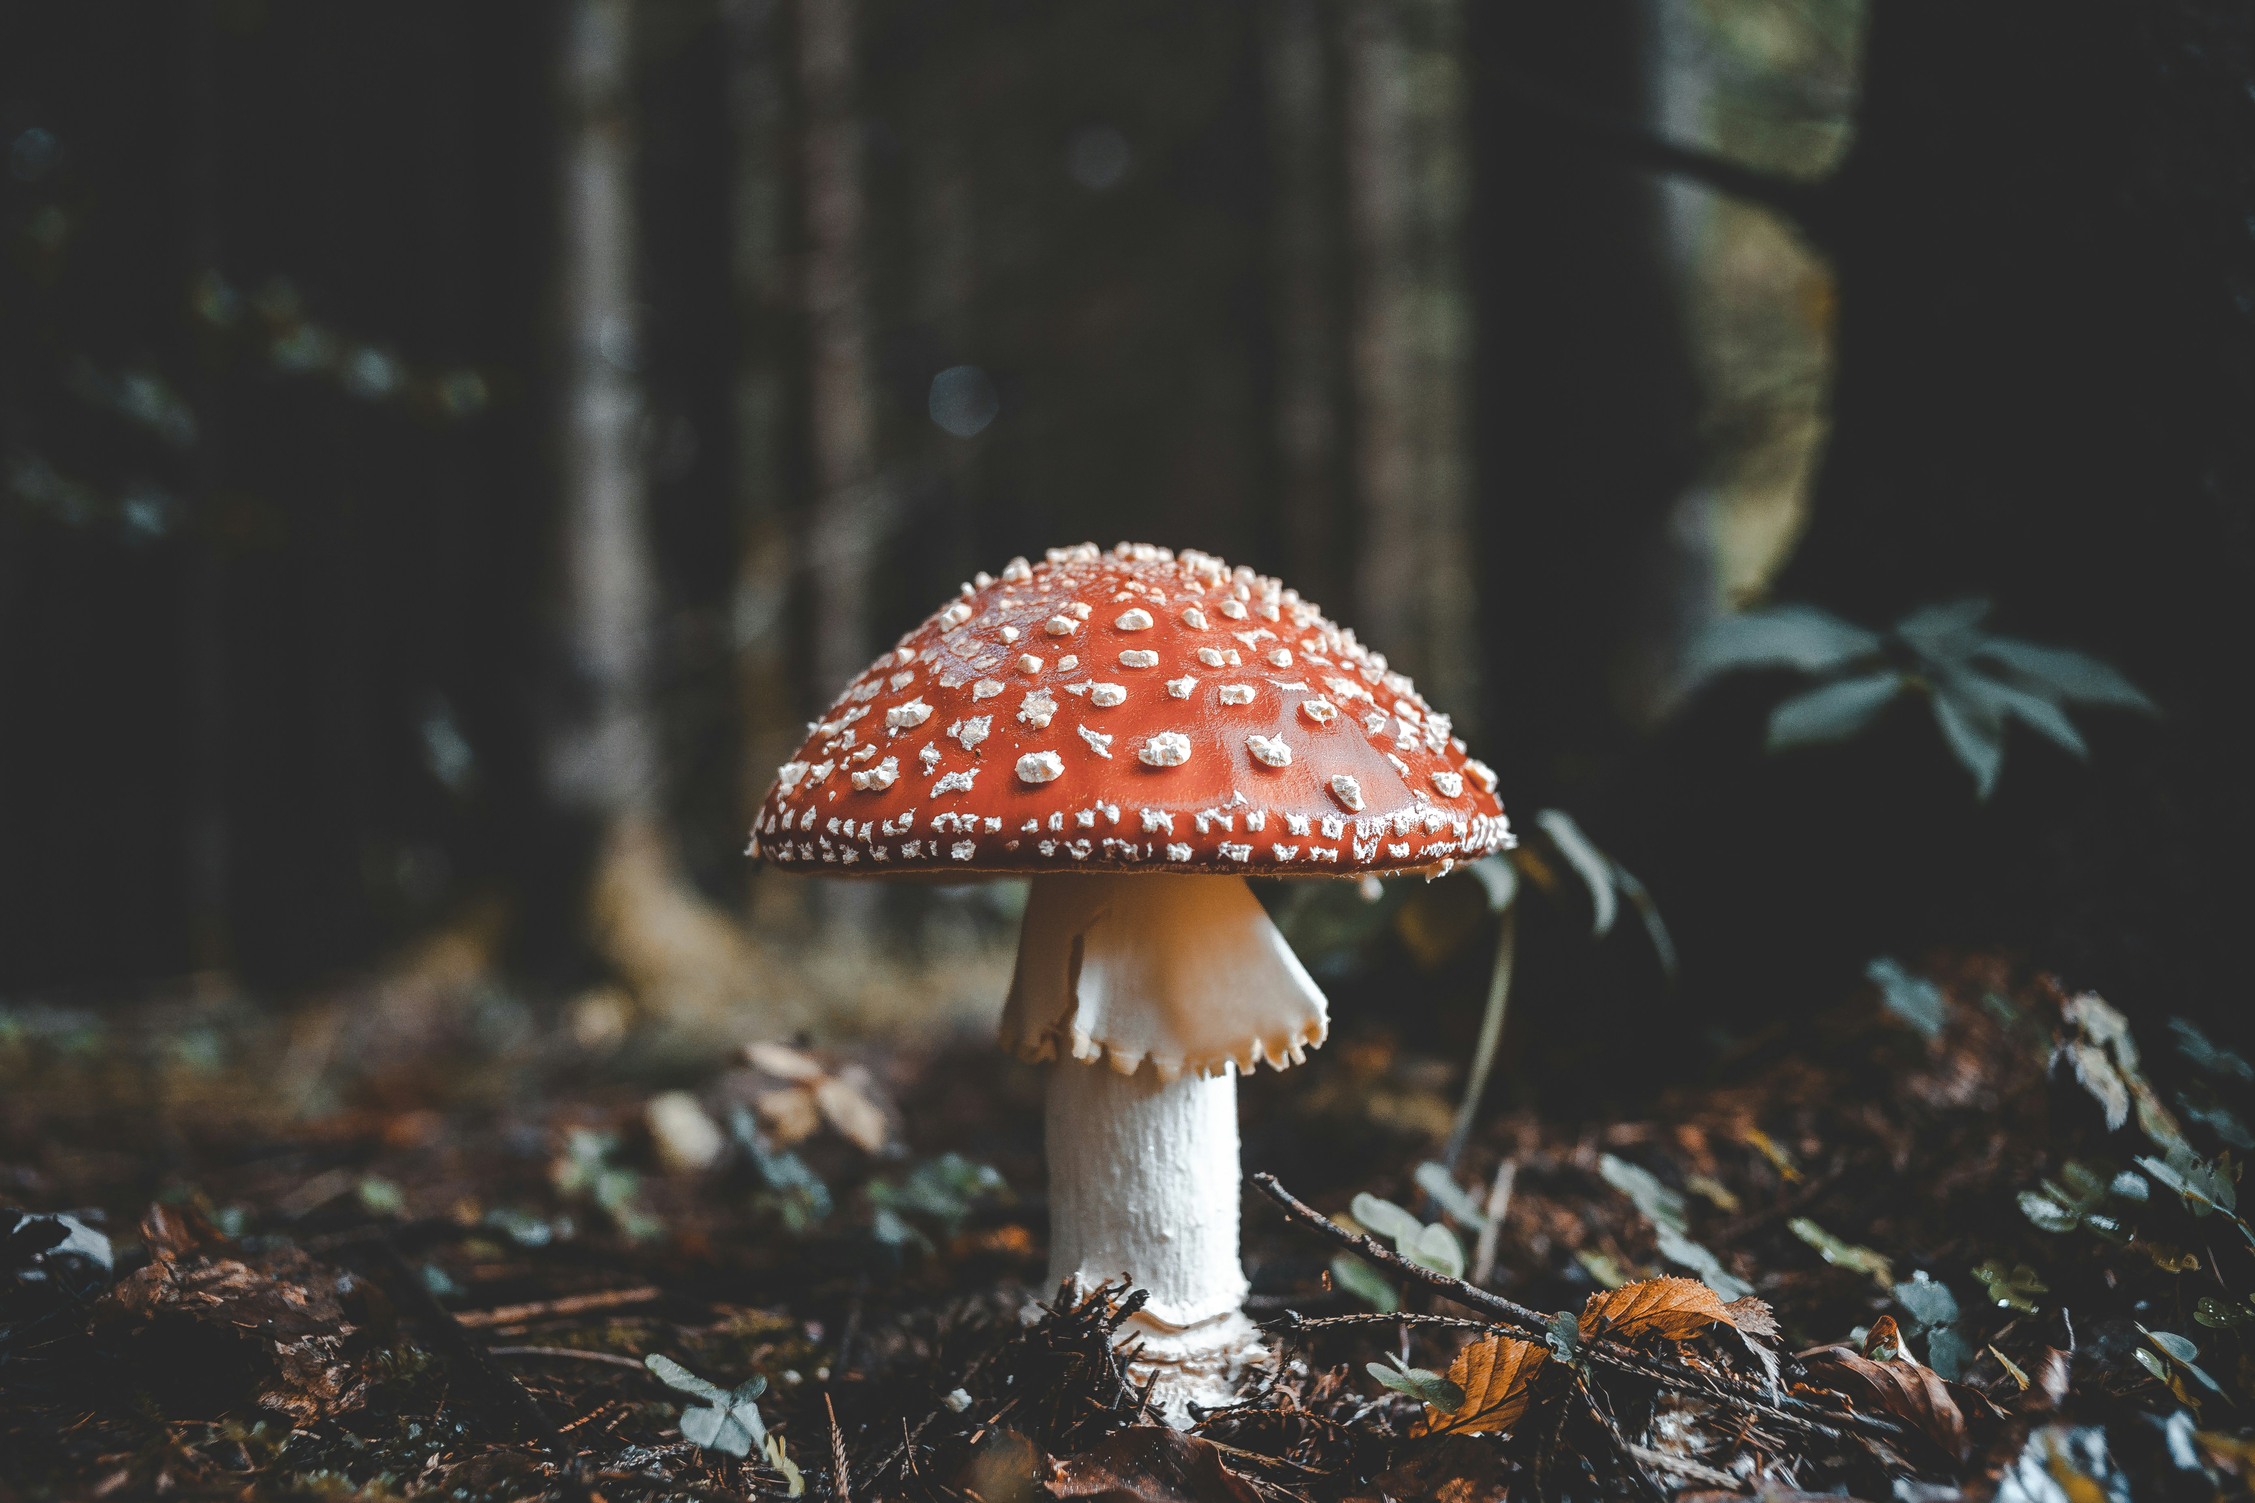
Problem
Photo by Florian van Duyn on Unsplash

Slide 3
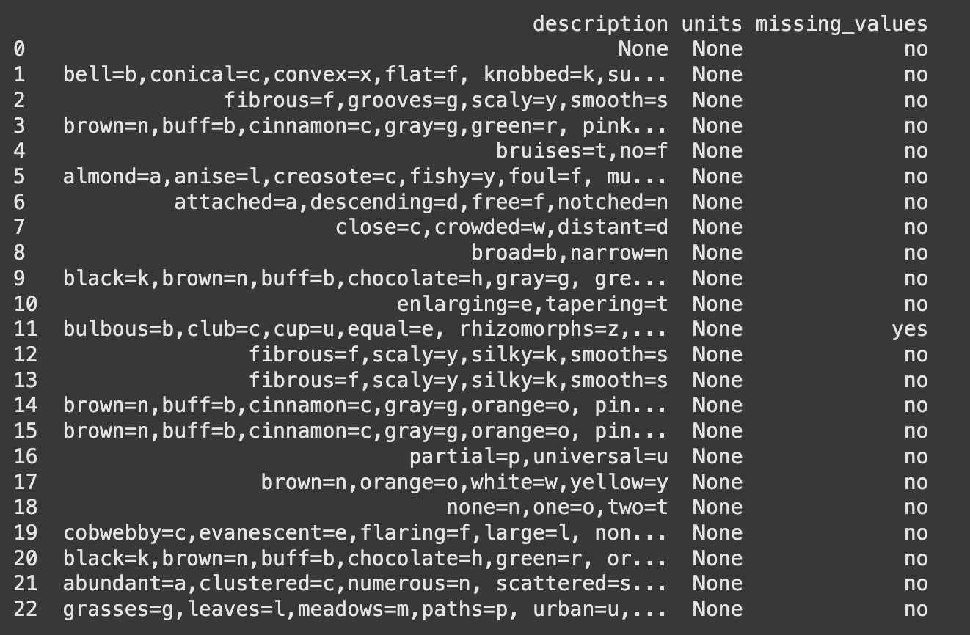
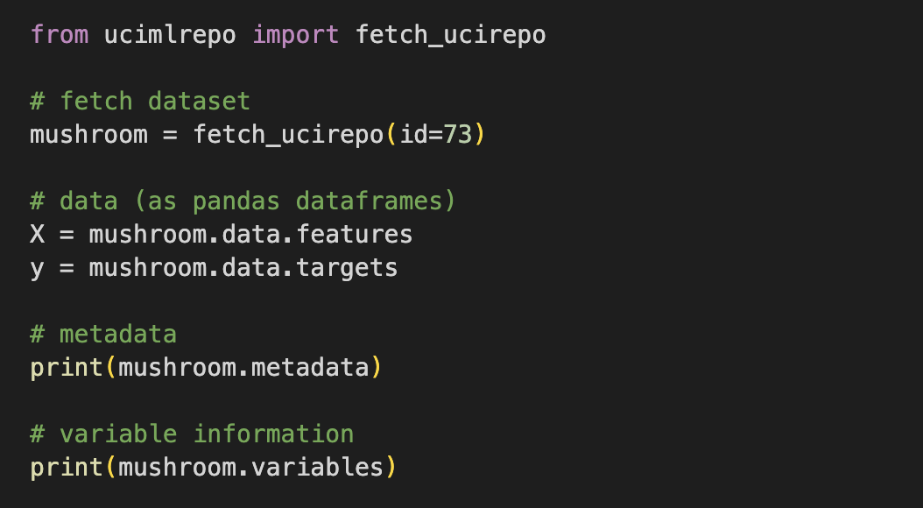
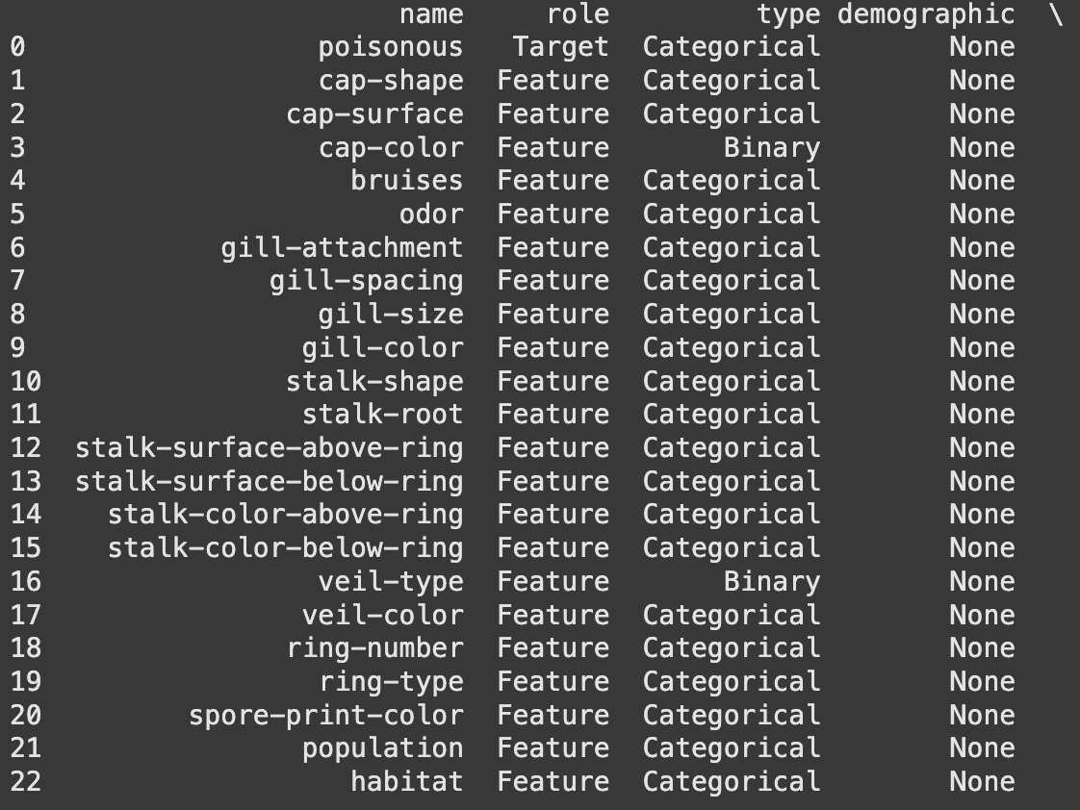
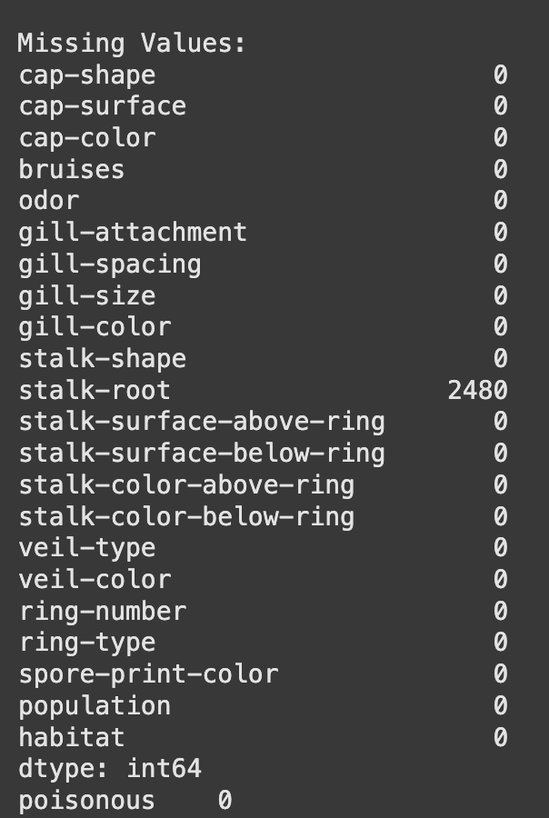
EDA

Slide 4
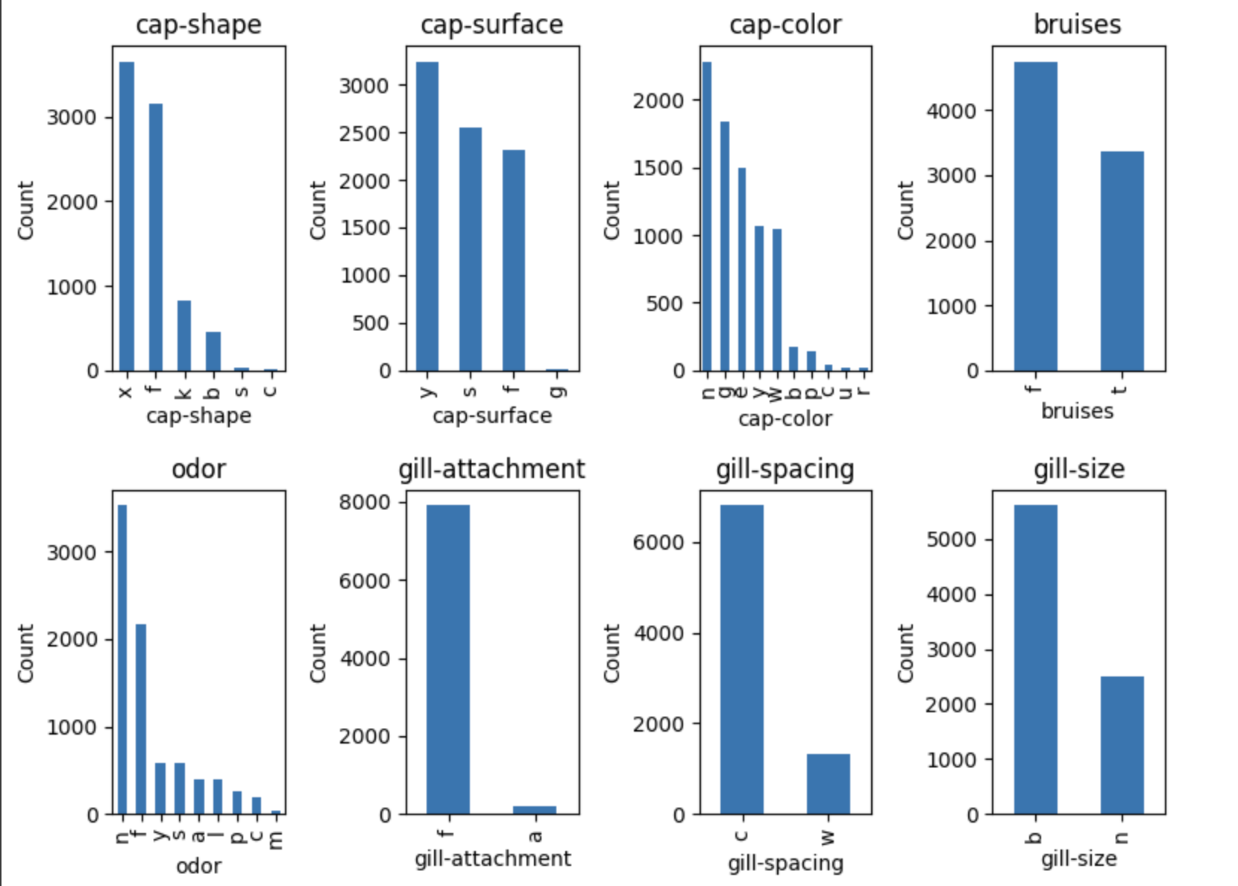
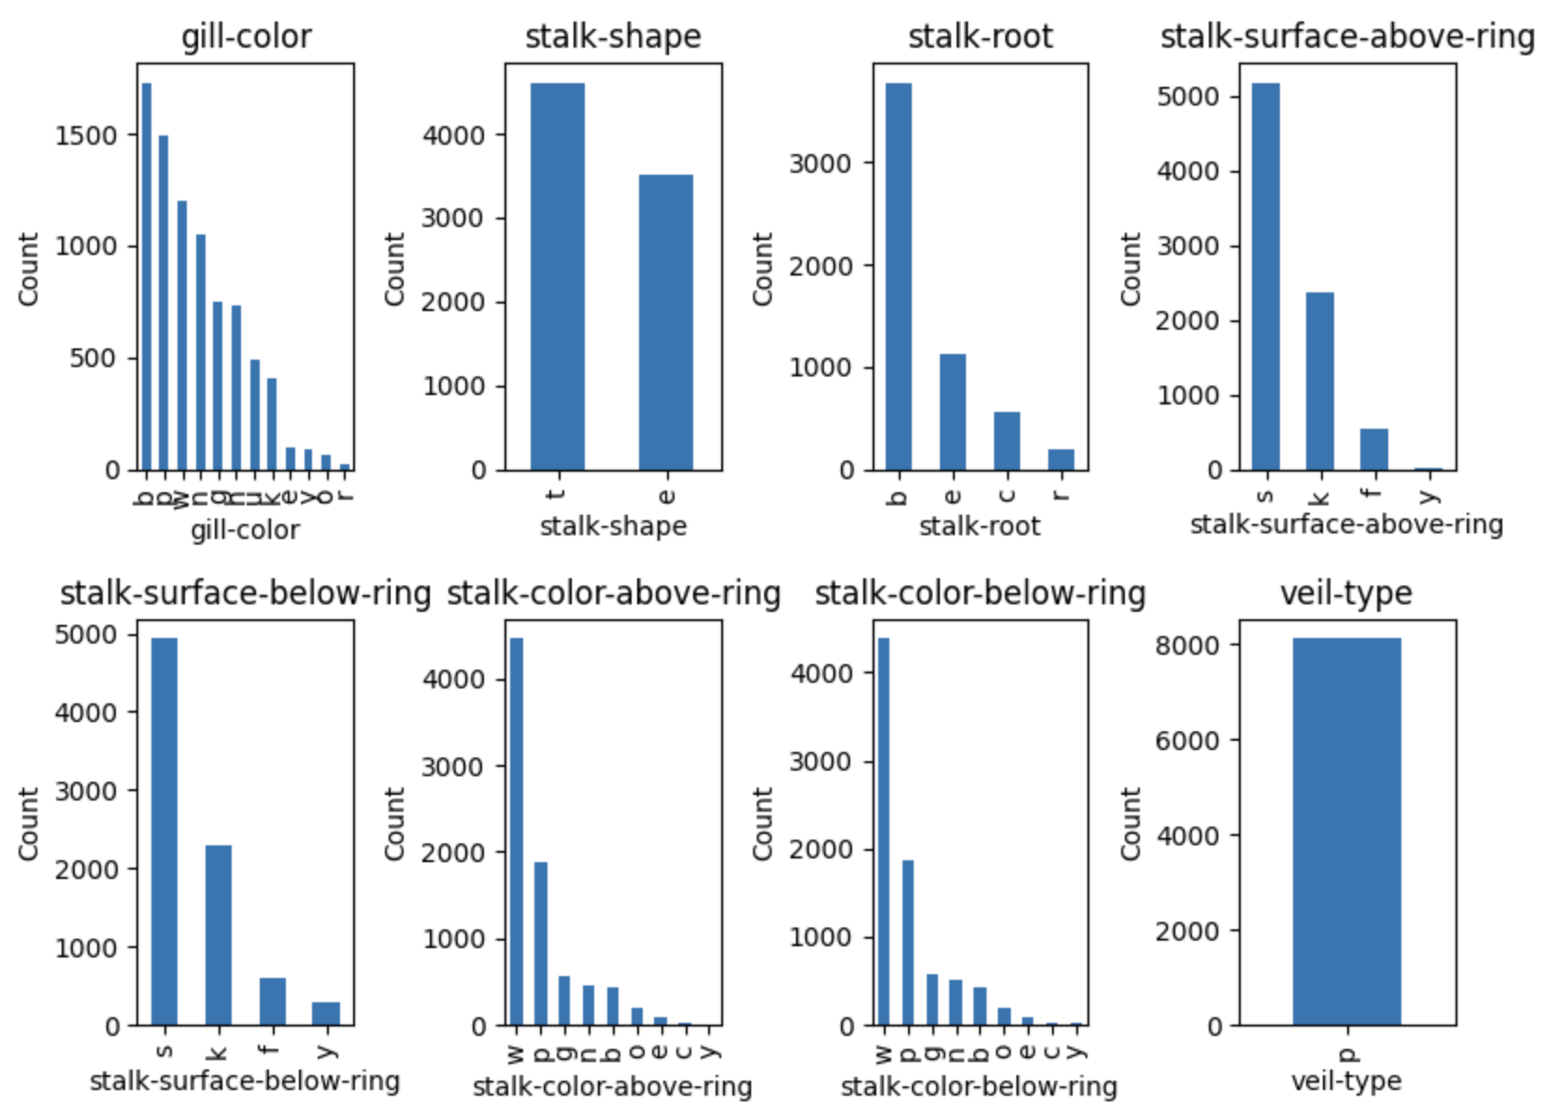
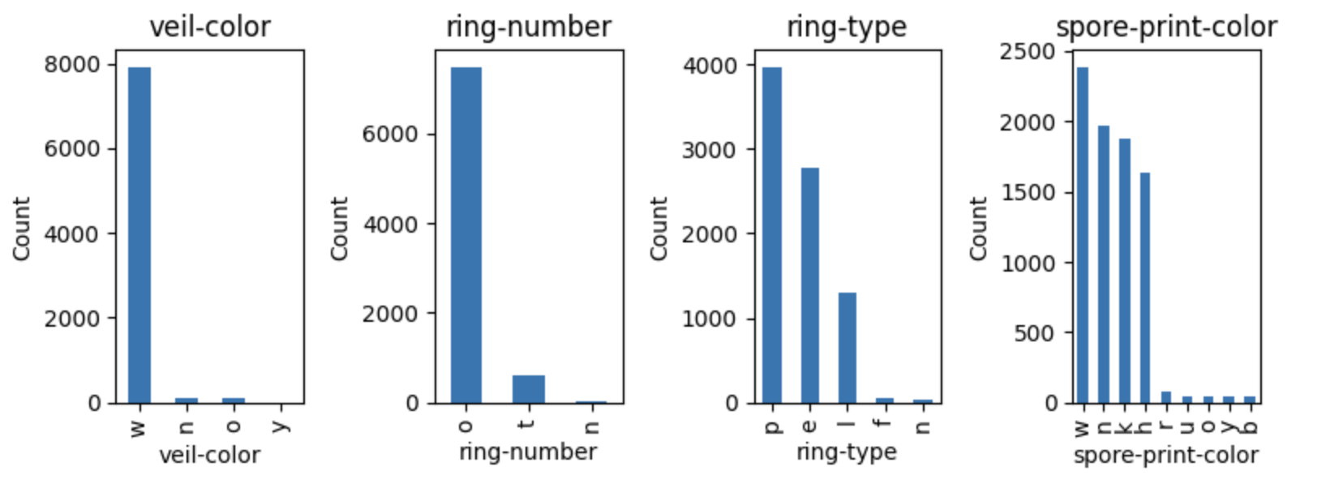
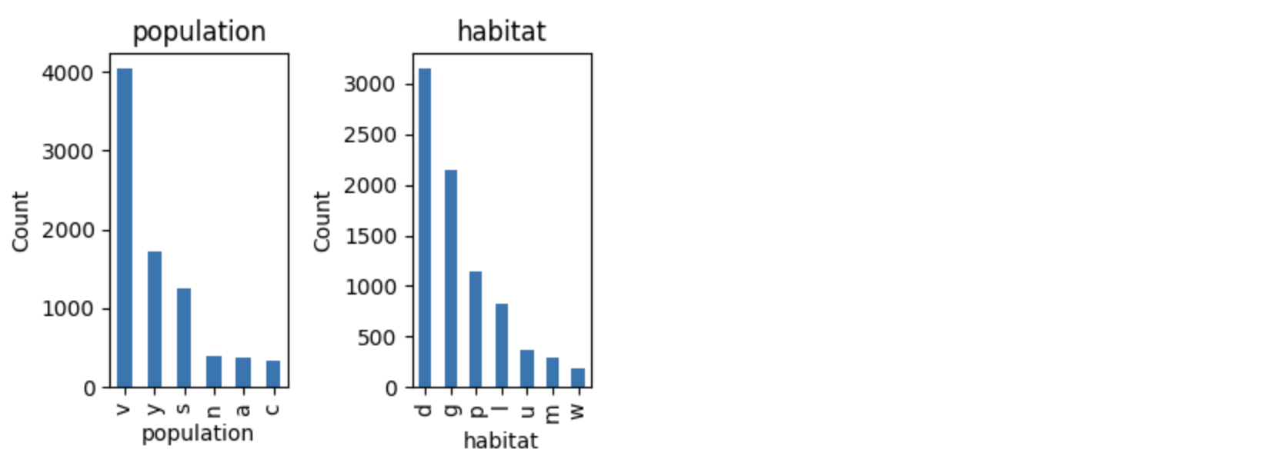
EDA

Slide 5
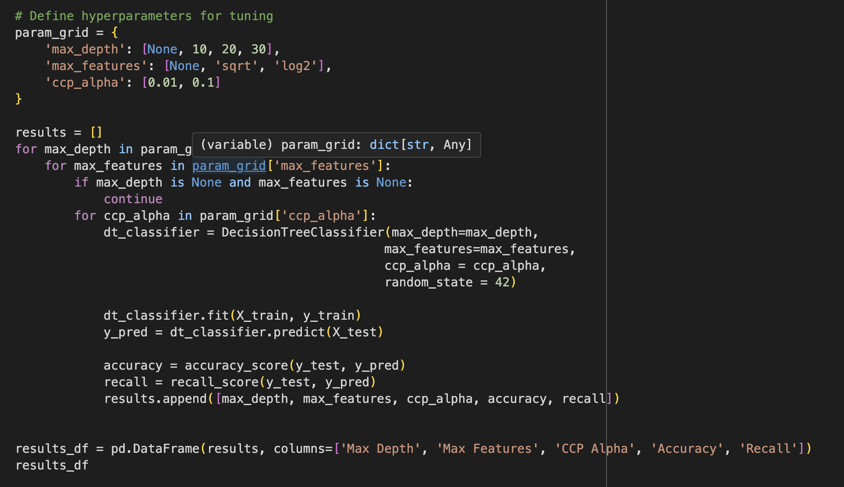
Modeling

Slide 6
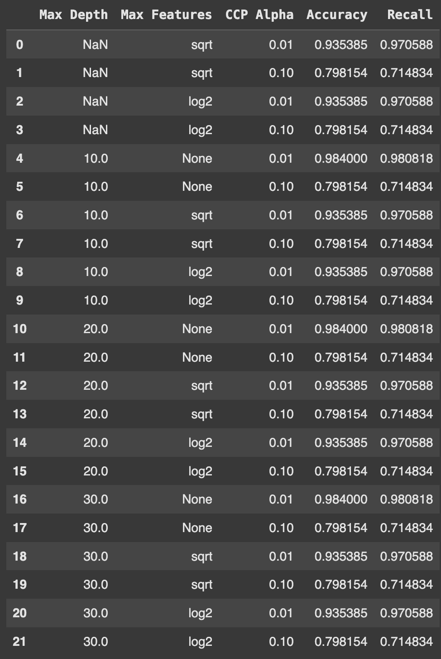
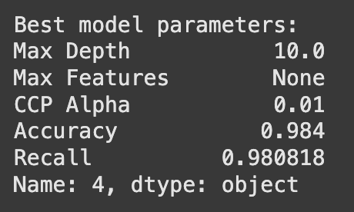
Analysis

Slide 7
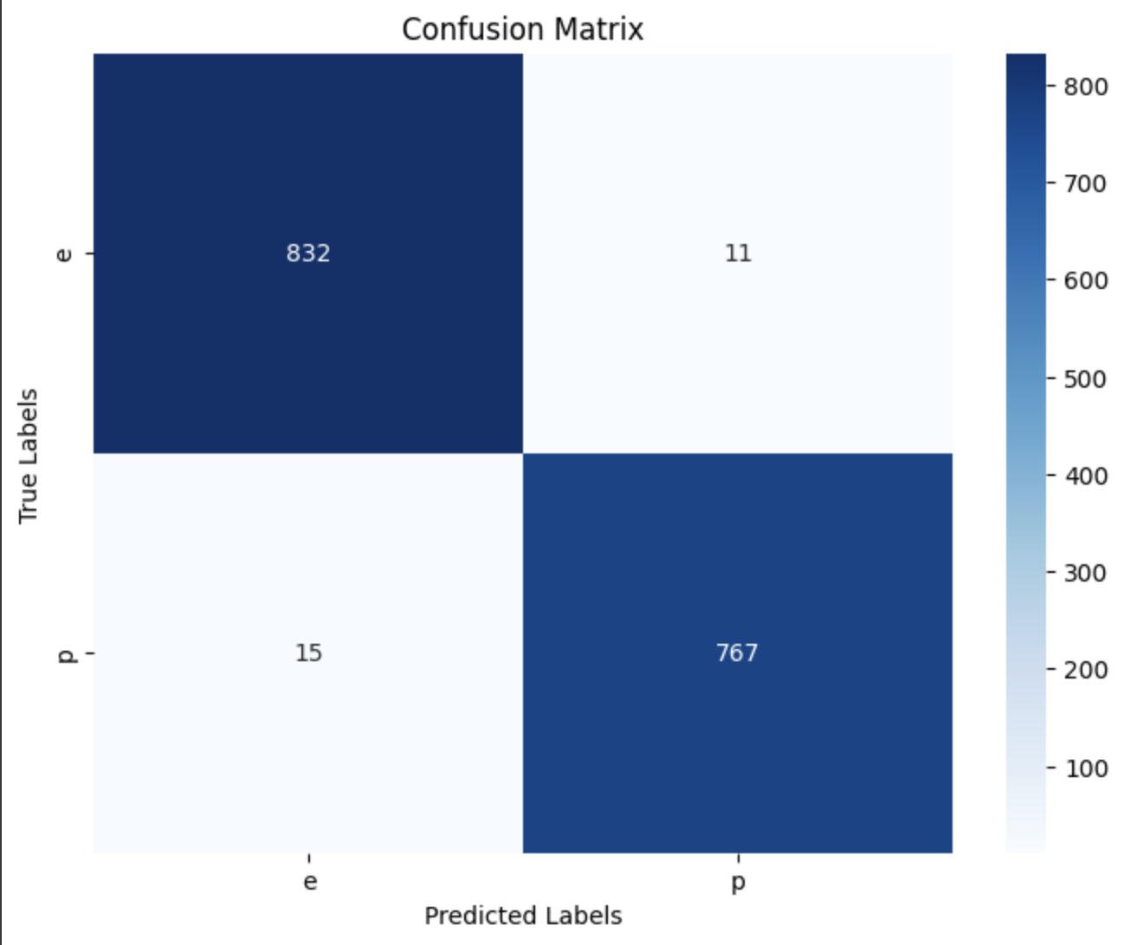
Conclusion

Slide 8
References
https://archive.ics.uci.edu/dataset/73/mushroom
https://scikit-learn.org/stable/modules/generated/sklearn.tree.DecisionTreeClassifier.html
https://scikit-learn.org/stable/modules/generated/sklearn.preprocessing.LabelEncoder.html
Week 4 Lab

